Slide 1
Aircraft Risk Analysis for New Aviation Business
Data Science – Phase 1 Project
26/07/2025

Slide 2
Business context
General Objective: To evaluate the new ventures for ‘Venus Airline’, both commercial and Private enterprises, to purchase and operate
Specific Objective:
To determine which aircraft are the lowest risk for the company to start this new business endeavour.

Slide 3
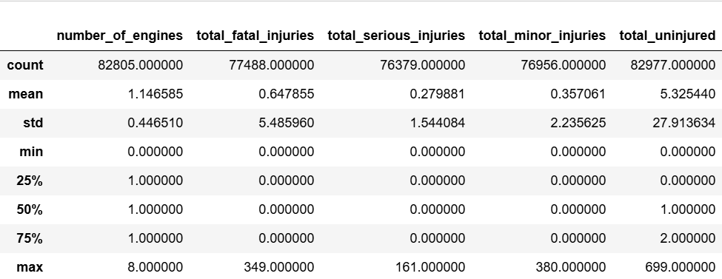
Descriptive statistics

Slide 4
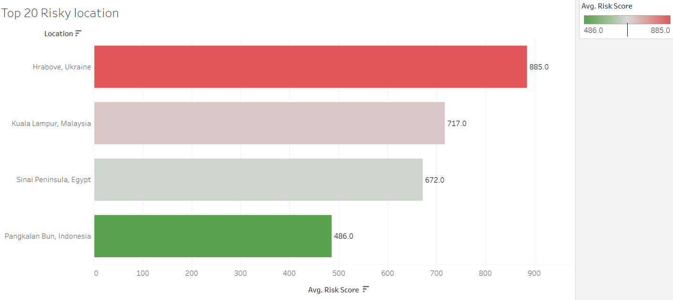
Risky location

Slide 5
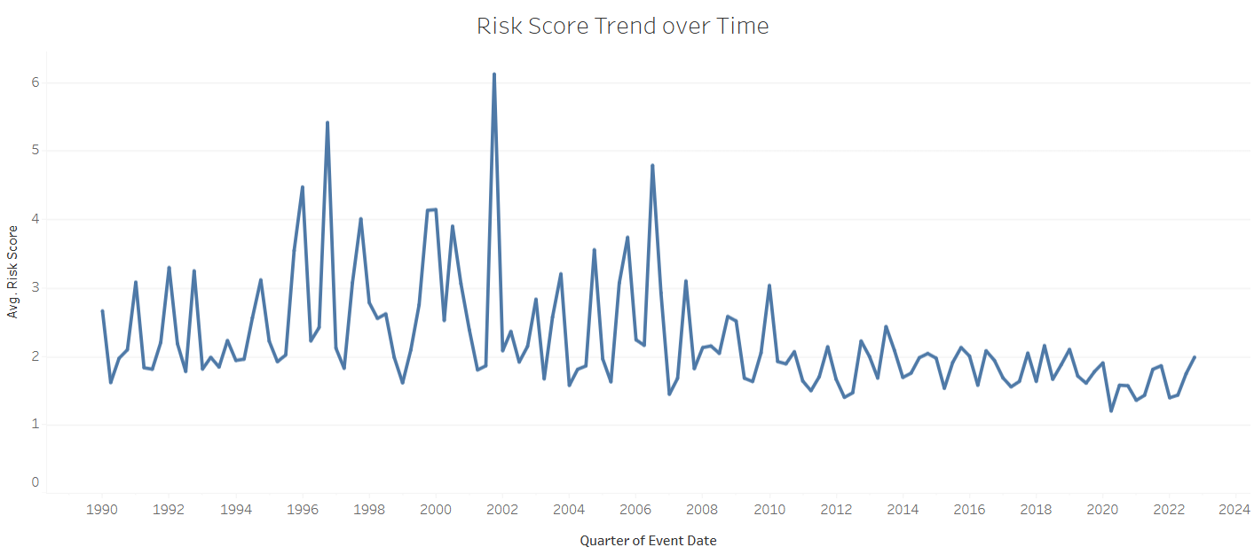
Trend of Risk Score over Time

Slide 6
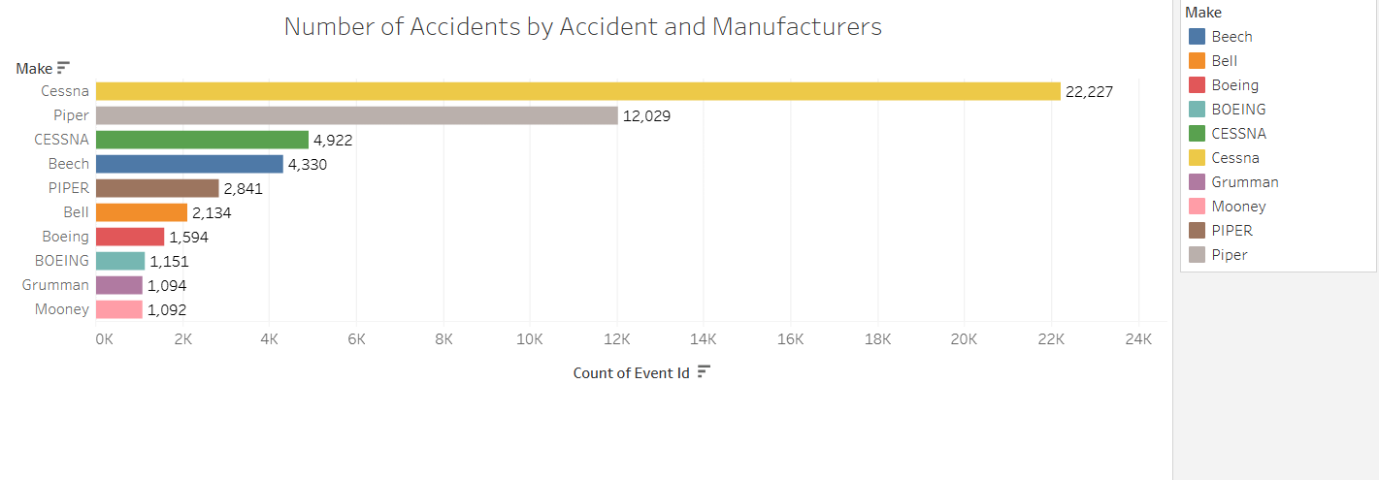
Number of accidents by Accidents and Manufacturer

Slide 7
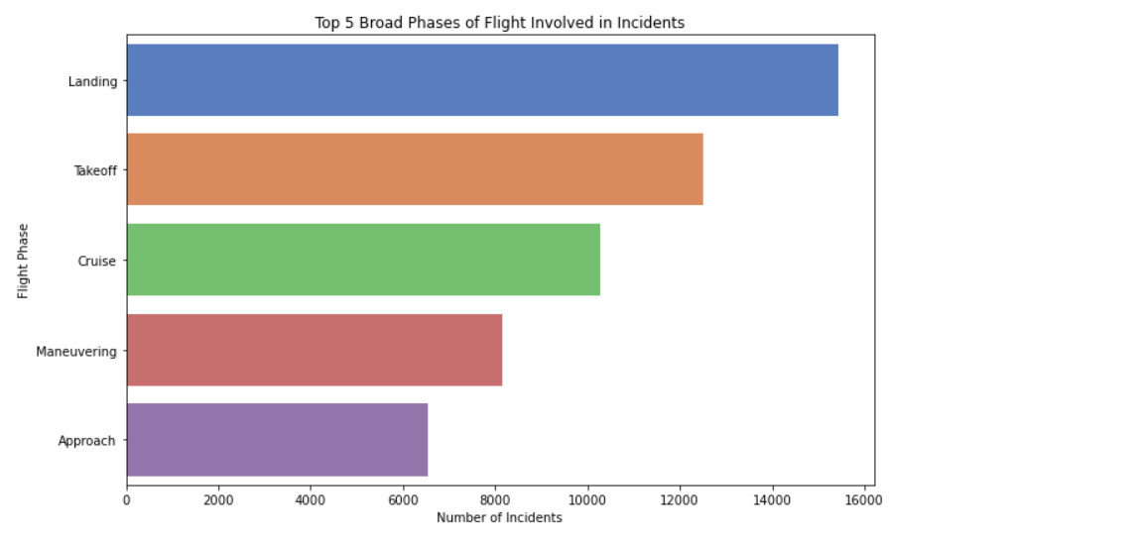
Top 5 Broad Phases of Flight Involved in Incidents

Slide 8
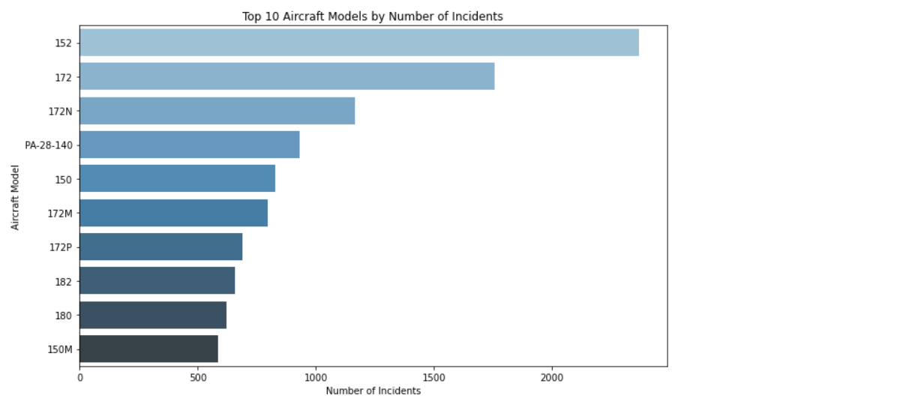
Top 10 Aircraft by Number of Incidents

Slide 9
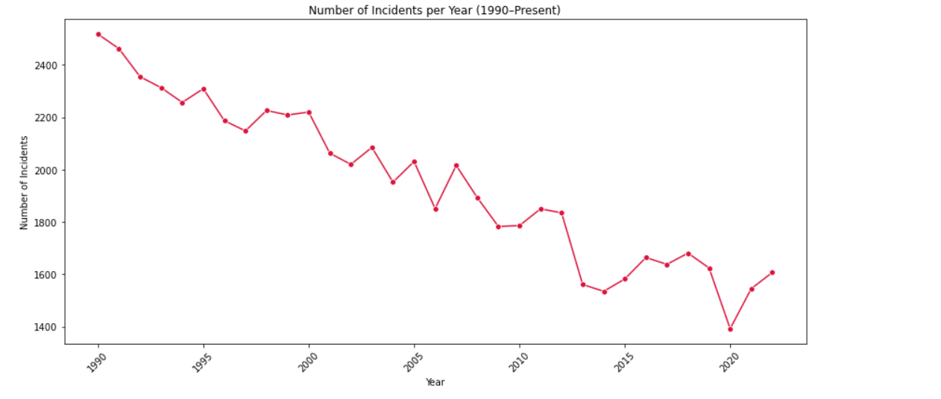
Trends in incidents per year (1990 – Present)
The number of incidents has generally declined since 1990, indicating improvements in technology, regulation, or reporting.

Slide 10
Results &business applications (recommendation)

Slide 11
Evaluation & Future improvement Ideas

Slide 12
Contact Information

